Slide 1
Anson County Comprehensive Transportation Plan (CTP)
Dominique Boyd, Roger Castillo
May 26, 2022

Slide 2

Vision Statement
Anson County CTP
This statement should capture the community’s vision for how the transportation system should function in the future.
Written in present tense
Describe the best outcome achievable
Does not specify timeframe or provide numeric measures
Helps build a picture for the community

Slide 3
Vision Statement Examples
Anson County CTP
2012 Anson County CTP
Produce and maintain a Comprehensive Transportation Plan to preserve and promote the quality of life and economic development of Anson County and all its municipalities that includes roadway systems, rail, transit, and sidewalks. This will be accomplished by providing an accessible, integrated, efficient, and safe transportation system.
2022 Foothills Regional CTP
The Foothills Region provides a safe, efficient, well-connected, accessible, multi-modal transportation system that enhances the mobility of its residents, supports economic development, sustainable land use patterns and a healthy lifestyle while preserving the region’s natural beauty and heritage.
2021 Macon County CTP
Macon County envisions a safe and reliable transportation network that accommodates all users and connects our people with the goods and services they need to thrive. This transportation system supports economic development opportunities, promotes healthy communities, and adapts to changing technologies while preserving the natural beauty and rural character of our county.

Slide 4
Goals and Objectives
Anson County CTP
Goals
  More General
  Separates the Vision statement into themes
Objectives
  More Specific
  What action is necessary to achieve the goal
  Measurable, reasonable, time-bound
  How is it going to be measured (Adding certain types of projects, relieving congestion, reduce # of crashes, etc.)
  Example
  Goal: Provide an efficient transportation system through improved connectivity, capacity, and operations
  Objectives:
  Promote reduction in recurring congestion through transportation capacity, access management, and policy improvements
  Increase travel flow through operational improvements such as additional turn lanes and signal removal

Slide 5

Goals and Objectives Survey
Anson County CTP
Used to refine and improve the Vision, Goals and Objectives
Identify community concerns
Feedback specific to local transportation systems
Examples
Polk County Survey
  https://polksurvey-demo.metroquest.com/
Macon County Survey
  https://maconmoves-demo.metroquest.com/

Slide 6
Distribution Methods
Anson County CTP
We want to reach out to as many people as possible. Examples of methods to increase outreach:
Libraries
Transit Buses
Local Shops
Community Centers
Schools
Local Newspaper
Social Media

Slide 7
Informational Maps
Anson County CTP
Planning level maps that represent the transportation network in the Base Year (2019)
Truck Traffic – Displays percent truck and the average trucks that pass each day throughout the year
Crash Frequency – Displays the number of crashes in Anson County (Years 2015 - 2019)
Crash Severity – Displays the number for serious or fatal crashes in Anson County (Years 2015 – 2019)
Bridge Deficiency – Displays the locations of deficient bridges
Environmental Maps – Displays various environmental features that are important to note or avoid

Slide 8
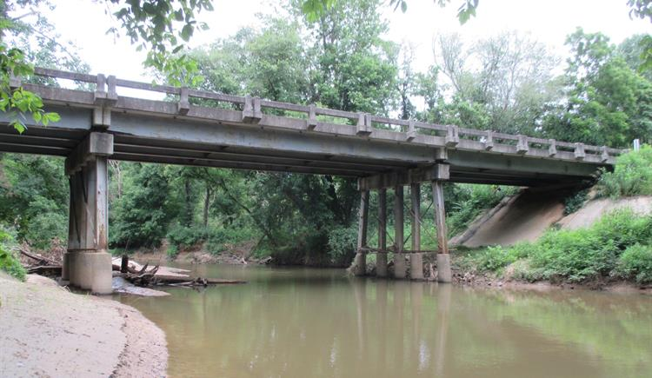
Deficient Bridge Map
Anson County CTP
This does not imply that they are likely to collapse or are unsafe
Structurally Deficient
  Bridge must be monitored, inspected, repaired/replaced to maintain structural integrity
Functionally Obsolete
  Bridge built to standards that are not used today
  May not have adequate lane widths, shoulder widths, vertical clearances, etc.
117 Bridges in Anson County
  16 Bridges are either Structurally Deficient or Functionally Obsolete along the Study Roads (26 Total)

Slide 9

Environmental Maps
Anson County CTP
Consider the Natural and Human Environment
Interagency Coordination with environmental resource agencies
Identifying Critical Areas
  Avoid/Minimize Impacts
  Opportunities that require coordination

Slide 10
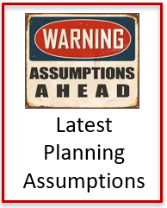
Base Year → Future Year
Macon County CTP
How is the county growing?
Where are people going?
What new locations will be added?
How has traffic changed over time?

Slide 11
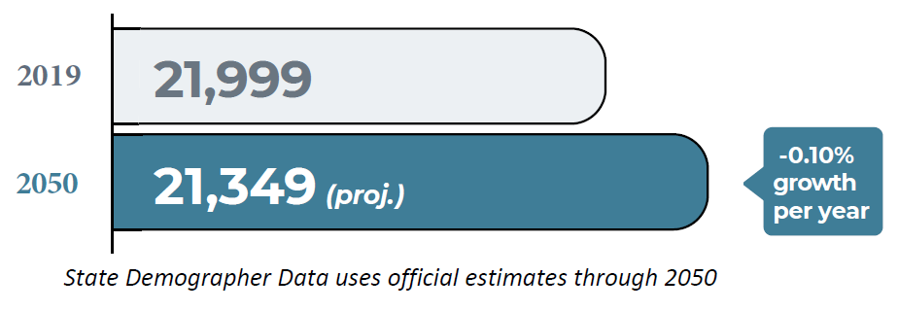
Anson County Trends
Anson County CTP
Anson County Population Projections
Anson County Employment
Year | Labor Force | Employed | Unemployed | Unemployment Rate (%)
2000 | 11,019 | 10,437 | 582 | 5.3
2005 | 10,656 | 9,811 | 845 | 7.9
2010 | 11,217 | 9,649 | 1,568 | 14.0
2015 | 10,817 | 10,119 | 698 | 6.5
2019 | 10,626 | 10,192 | 434 | 4.1
https://www.bls.gov/lau/#tables
U.S. Bureau of Labor Statistics
https://www.osbm.nc.gov/facts-figures/population-demographics/state-demographer/countystate-population-projections
*Projections by the North Carolina OSBM
Anson County Growth Rate

Slide 12
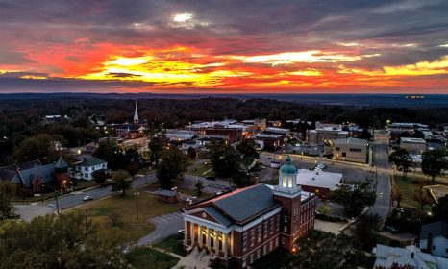
Planning for the Future
Anson County CTP
What type of new development is planned in the County? (ex. New businesses, relocations, improvements)
What are some highly trafficked areas? (tourism, seasonal, large county event locations)

Slide 13
Contacts
Anson County CTP
NCDOT Transportation Planning Division (TPD)
  Dominique Boyd, dlboyd1@ncdot.gov, (919)-707-0932 (Project Manager)
  Roger Castillo, ricastillo@ncdot.gov, (919) 707-0942 (Project Engineer)
Rocky River Rural Planning Organization (RPO)
  Lee Snuggs, lsnuggs@rockyriverrpo.org, (704) 986-3871

Slide 14

QUESTIONS

